Slide 1
BRH System for Treatment of Chronic Ulcers
Improving the health and well-being of sufferers of chronic wounds

Slide 2
BRH Medical
Founded in 2010 by Mr. Ilan Feferberg, the company’s CTO, a graduate of the elite 8200 Israeli Intelligence Corp.
Development stage, high technology start-up
Designs, develops and manufactures advanced medical devices and solutions for chronic wound care
Our products implement a novel, patent-pending technology that combines therapeutic ultrasound and electrostimulation

Slide 3
Company Vision
Our vision is to impact the healthcare system by providing life-changing, cost-effective high tech alternatives to overcome the challenges of wound management, care and closure.
We are guided by strict codes of responsible medicine, while developing high performance products for excellent results.

Slide 4
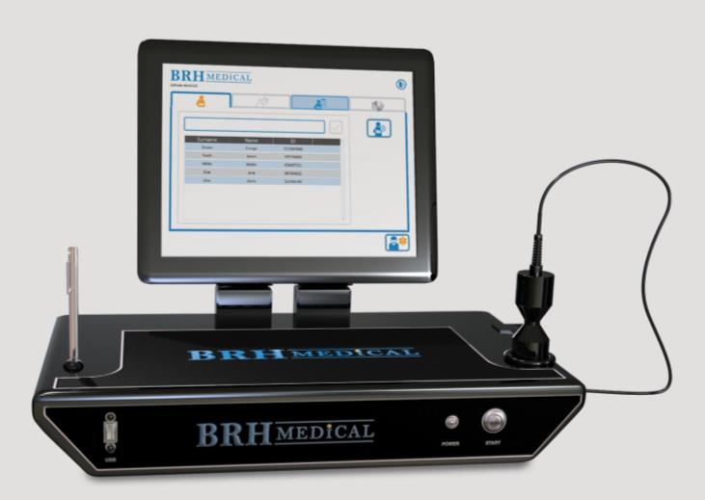
BRH-A2 Therapy System
Non-invasive, portable device intended to heal chronic ulcers, reduce lesion size and wound pain, and accelerate tissue regrowth
Consists of an ultrasound unit and an electrostimulation unit combined in one product
Equipped with touch screen and transducer

Slide 5
BRH Innovative Wound Healing
The BRH-A2 combines the benefits of two proven therapies:
Therapeutic ultrasound & electrostimulation
Modulation both individually and in combination during the treatment period creates a “micro-circulation” effect
Micro-circulation is a massage-like process within the tissues and blood vessels of the wound, increasing the blood flow to significantly increase the healing rate.

Slide 6
Science Behind the Technology
The ultrasound unit transmits different ultrasound waves at specific frequencies and intensities to the wounded region of the body.
The ultrasound system works simultaneously with the electrostimulation fields to affect the tissues and muscles in the region of, and below the wound.
This combination varies in frequency and intensity over the course of the treatment.

Slide 7
Clinically Proven
DESCRIPTION In an open label non-randomized, non-controlled study in Israel evaluating the effect of BRH therapy on Venous Leg Ulcers (VLUs) and on Diabetic Foot Ulcers (DFUs) ¹
METHOD BRH therapy was applied at each treatment visit for a period of 30 minutes. Electric stimulation was applied across the wound bed with the electrodes being placed around the outside of the wound bed on the healthy surrounding tissue. Ultrasound was applied both directly to the wound bed as well as to the immediately surrounding tissue in small circular motions for the 30 minute treatment duration.
RESULTS During this study, results of the treatment included reduction in wound pain and accelerated initial tissue regrowth.
¹Combined Ultrasound and Electric Field Stimulation in the Treatment of Chronic Ulcerations, J Rosenblum DPM, Director; Diabetic Foot Service, Shaarei Zedek Medical Center, Jerusalem, Israel (submitted for publication)

Slide 8
Clinical Results
General description of results showing 50% closure at 4 weeks
Wound | Success |  | Total # Pts
 | No | Yes
Diabetic Count % Within Wound | 11 42.3% | 15 57.7% | 26
Venous Count % Within Wound | 11 30.6% | 25 69.4% | 36
Total Count % Within Wound | 22 33.8% | 40 66.2% | 62 100.0%

Slide 9
Regulatory and Quality Status
CE Mark
FDA 510K Submission
ISO 13485/2003 Certified

Slide 10
BEFORE & After Photos

Slide 11
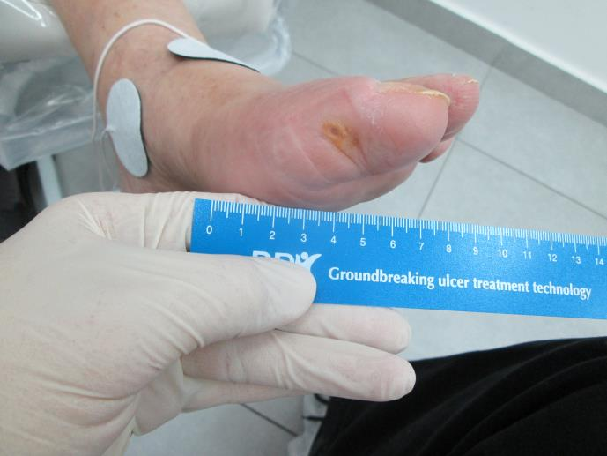
Before and After
Patient #1
32 treatments over 12 months

Slide 12
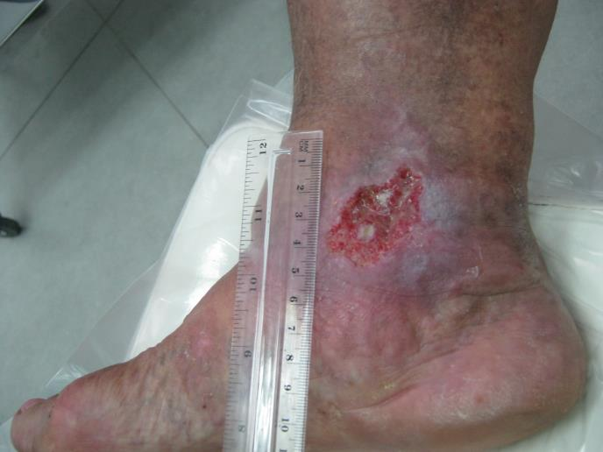
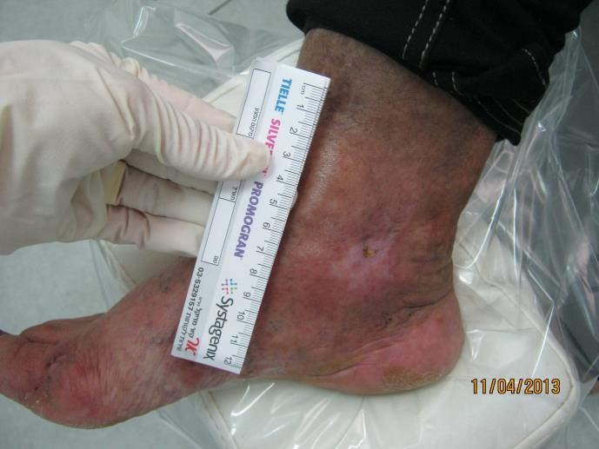
Before and After
Patient #2
19 treatments over two months

Slide 13
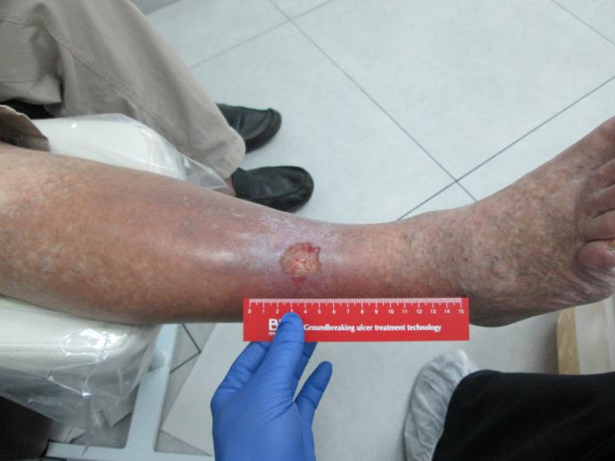
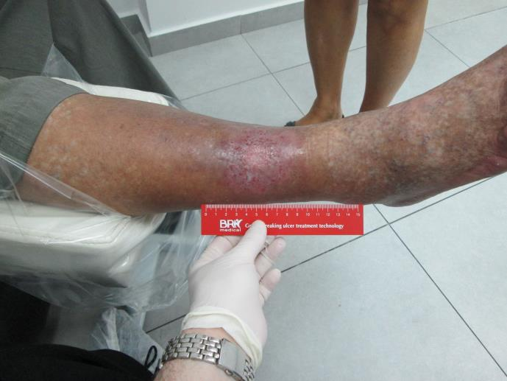
Before and After
Patient #3
5 treatments over 2months

Slide 14
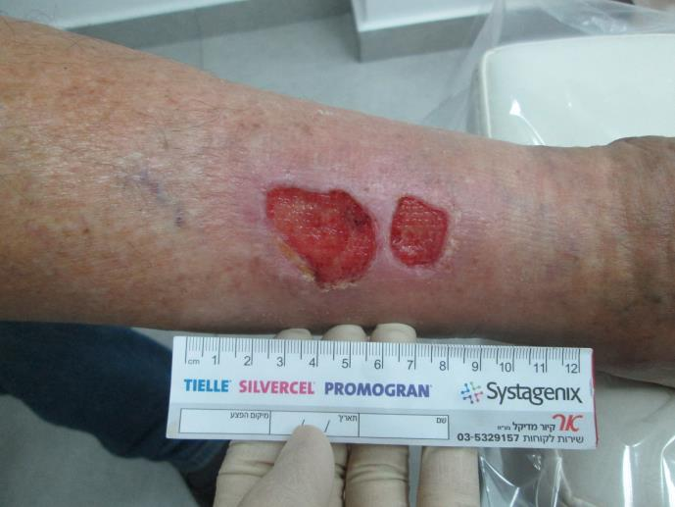
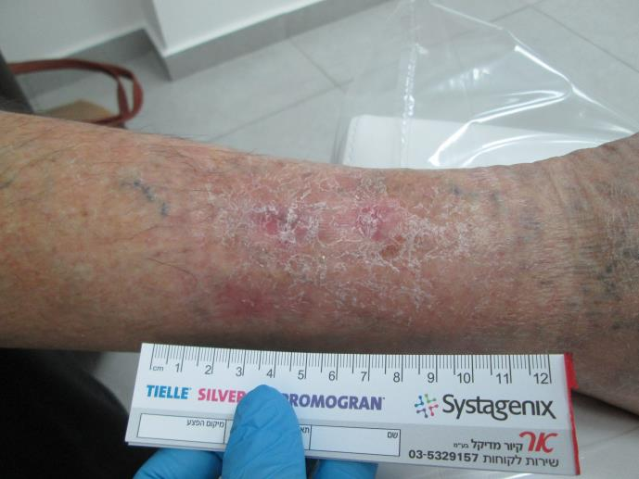
Before and After
Patient #4
14 treatments over 3months

