Slide 1
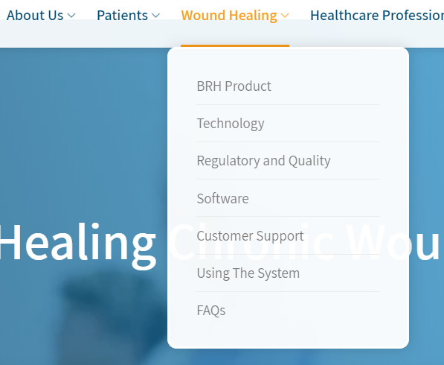
Change to Products
Wound Healing
Pain Relief

Slide 2
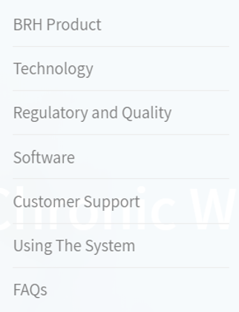
2 product pages:
Wound Healing
Pain Relief
  ActiWound (same content as the original)
  ActiVessel (with the description: FINALLY, YOUR CLINIC CAN SUCCESSFULLY TREAT:
    CARPAL TUNNEL SYNDROME
    PLANTAR FASCIITIS
    PERIPHERAL NEUROPATHY
    DIABETIC ULCERS
  Therapeutic ultrasound has been commonly used by medical practitioners for the last 60 years. What is not commonly known is that ultrasound loses its effectiveness just a few minutes into a treatment session.
  This happens because after the first few minutes, in which the ultrasound waves penetrate the skin's barrier, the body recovers and forms an impenetrable blockade. This obstructs the ultrasound waves from effectively performing their intended job, thus preventing successful treatment.
  ACTIVESSEL IS THE ONLY TECHNOLOGY THAT GETS PAST THE BLOCKADE, ENABLING AN ENTIRE SESSION OF EFFECTIVE TREATMENT.
  Add a button: “More Details” and link to https://www.activessel.com/

Slide 3
About us text:
In 2010, Mr. Ilan Feferberg, a veteran of the elite intelligence unit, 8200 (a combination of DARPA & the NSA), invented a unique therapeutic platform. He developed and patented a combination of UltraSound and Electric Field Stimulation, two clinically proven and commonly employed modalities. Together, they work synergistically, increasing blood flow to ischemic areas, to treat and heal chronic wounds & ulcers and other neuropathic and nerve-related complications (FDA, CE, HSA, AMAR, TGA approved).
BRH core technology has been the subject of several peer-reviewed publications & clinical studies & won the 8200 Israeli (IDF) elite unit innovation prize.
Today, BRH offers a noninvasive, non-surgical, non-narcotic treatment for:
CARPAL TUNNEL SYNDROME
PLANTAR FASCIITIS
PERIPHERAL NEUROPATHY
DIABETIC ULCERS

Slide 4
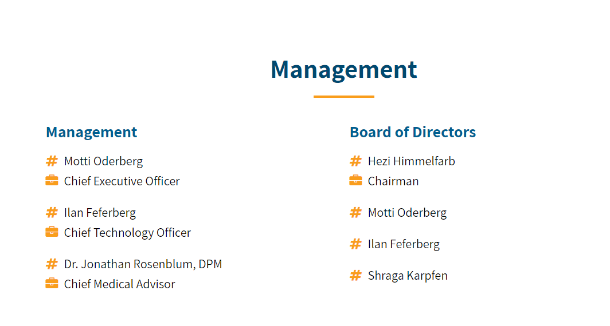
Management and board:
Align with the list in https://www.curesound.co/#Leadership
Without Sagi Reuven

Slide 5
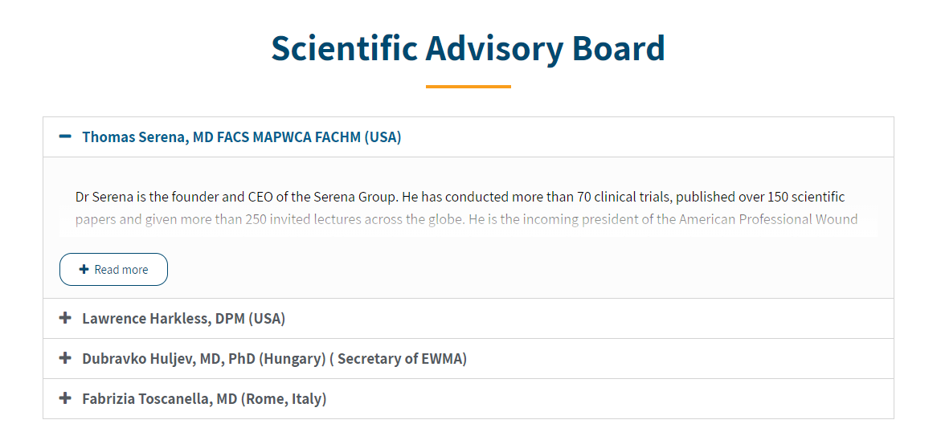
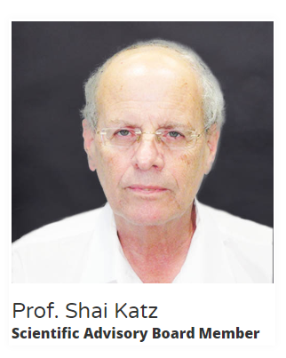
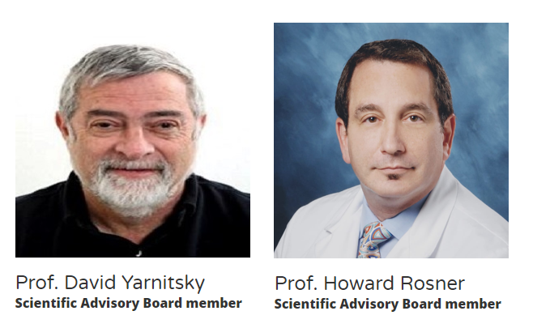
Add from https://www.curesound.co/#Leadership

Slide 6
Add to FAQ
Question: Can I perform the treatment myself?
Answer: No. The ActiVessel & Actiwound systems must be operated by a trained professional in a medical clinic.
Treatment duration: The actual treatment is between 15-40 minutes long, however, you can expect that the whole procedure may take up to 30-45 minutes including the time it takes to remove all bandaging and then redress the wound. In case of pain, it may be shorter.

Slide 7
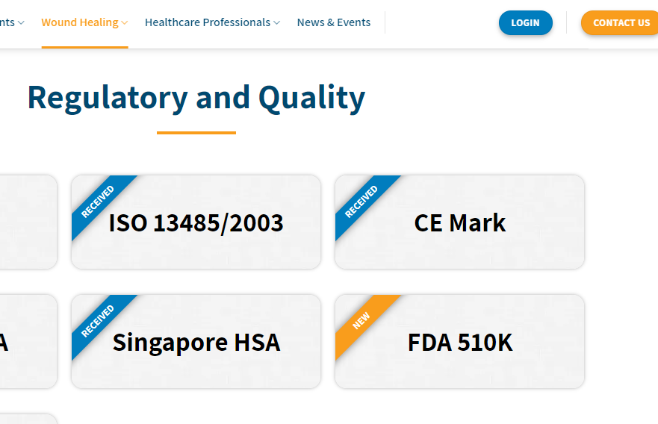
Change to RECEIVED as the others

